Slide 1
Sprint 3
Jordy Walraven

Slide 2
Sprint goals
As a developer, I need to understand how various services or components within the system communicate with each other, so that I can ensure seamless interaction and integration between different parts of the system.
As an admin I want to import games from steam, so that PC-gamers can submit their fps data for this game
As a developer, I need to deploy a scalable application to accommodate varying levels of user demand, ensuring that the system can efficiently handle increased traffic without compromising performance or reliability.

Slide 3
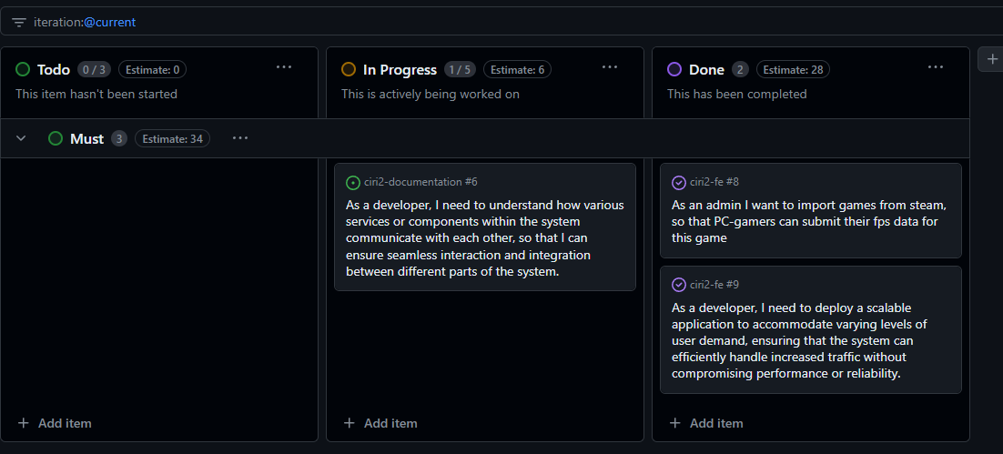
Sprint achievements

Slide 4
Relevant updated documentation
Research Report
Technical documentation

Slide 5
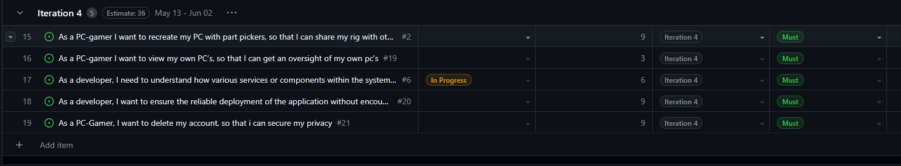
Sprint planning
https://github.com/orgs/CIRI2-s6/projects/2/views/2

